Slide 1
Comprehensive Evaluation of Association Measures for Software Fault Localization
LUCIA, David LO, Lingxiao JIANG, Aditya BUDI
Singapore Management University

Slide 2
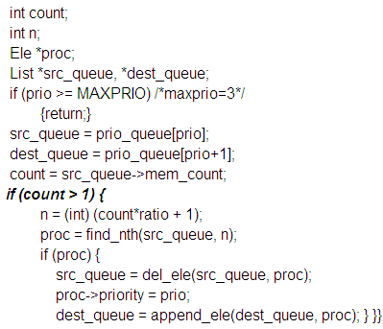
Introduction
A Buggy Program
Automated
Fault Localization
Test
Cases
Failure
Where is
the fault ?
Candidate of suspicious program elements

Slide 3
Fault Localization Techniques
Many fault localization techniques have been proposed.
One family of techniques: Spectrum-based fault localization (Reps et.al, 1997)
Use program spectra
(the representation of program behavior during execution)
Notes:
Specturm-based :Small CPU time and good accuracy

Slide 4
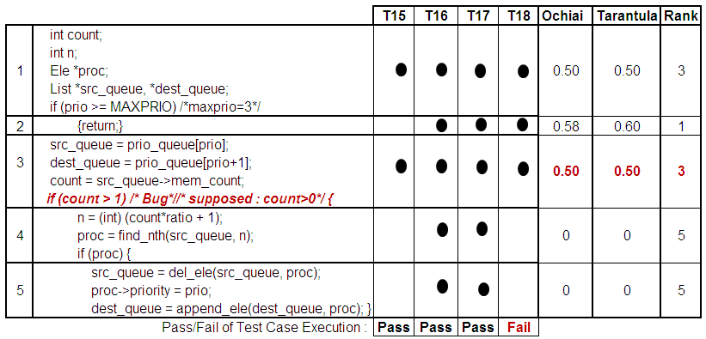
An example of spectrum
Test Cases

Slide 5
Spectrum-based Fault Localization
Idea
Program element that frequently occurs in failed test case is likely to contain bug
Example of existing measures :
Tarantula, Ochiai, etc.

Slide 6
Spectrum-based Fault Localization
Test Cases

Slide 7
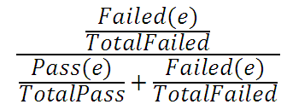
Spectrum-based Fault Localization
Tarantula (Jones and Harrold, 2005)
Ochiai (Abreu et.al, 2007)

Slide 8
Our Contributions #1
Tarantula & Ochiai model fault localization as the association between
The execution of program elements with occurrence of fault
We model fault localization as the association between
The execution or non-execution of program elements with occurrence of fault

Slide 9
Modeling Fault Localization with Association Measures
Suspiciousness score of a program element (e) is defined using an association measure (M) as follows:
A Non-control element
M(EXECUTION(e), FAILURE)
A Control element
Maximum of
M(EXECUTION(e), FAILURE) and
M(Non-Execution(children of e), Failure)
Notes:
Many association measures have been proposed, but have not been evaluated for fault localization.

Slide 10
Our Contributions #2
Evaluate the accuracies of 20 association measures for fault localization.
Evaluate their relative performance as compared to Tarantula and Ochiai.

Slide 11
Existing Association Measures (Tan et.al, 2002, Geng and Hamilton, 2006, Cheng et.al.,2009)
Association M.
1 | Coefficient
2 | Odd Ratio
3 | Yule’s Q
4 | Yule ‘s Y
5 | Kappa
6 | J-Measure
7 | Gini Index
8 | Support
9 | Confidence
10 | Laplace
Association M.
11 | Conviction
12 | Interest
13 | Cosine
14 | Piatetsky-Shapiro
15 | Certainty Factor
16 | Added Value
17 | Collective Strength
18 | Jaccard
19 | Klosgen
20 | Information Gain

Slide 12
Modeling Fault Localization with Association Measures
Block 1 | Execute | !Execute
Failed | 1 | 0
Passed | 3 | 0
Block 2 | Execute | !Execute
Failed | 1 | 0
Passed | 2 | 1

Slide 13
Modeling Fault Localization with Association Measures
Block 1 | Execute | !Execute
Failed | 1 | 0
Passed | 3 | 0
Block 2 | Execute | !Execute
Failed | 1 | 0
Passed | 2 | 1
e.g. Cosine
A=Execute, B=Failed
A=Execute, B=Failed
A=Not Execute
B=Failed
Notes:
Cosine example with formula

Slide 14
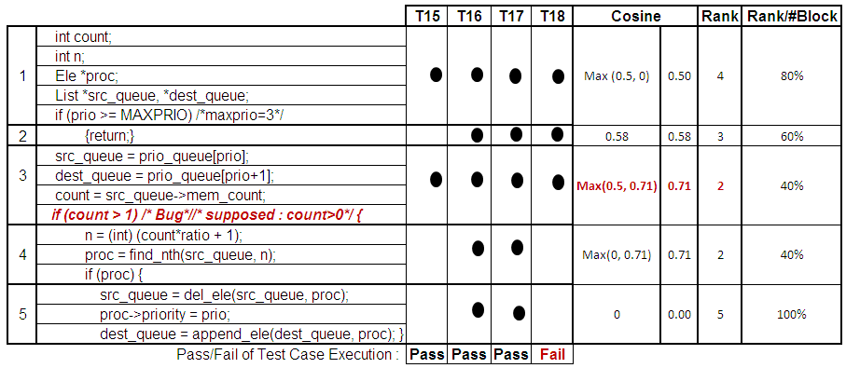
Modeling Fault Localization with Association Measures

Slide 15
Evaluation using Siemens Dataset
Dataset | LOC | #Faulty Versions | No. of Test Cases
Print_tokens | 472 | 5 | 4030
Print_tokens2 | 399 | 10 | 4115
Replace | 512 | 31 | 5542
Schedule | 292 | 9 | 2650
Schedule2 | 301 | 10 | 2710
Tcas | 141 | 36 | 1608
Tot_Info | 440 | 19 | 1052
Total : 120 buggy versions
dad
Notes:
Siemens dataset contains : original version and test cases.. So we can obtained the pass/fail information
Each dataset has one bug, but it can span to multiple locations (blocks)
Each dataset has several buggy versions
We excludes versions containing bug in data declarations
And also identical to the original

Slide 16
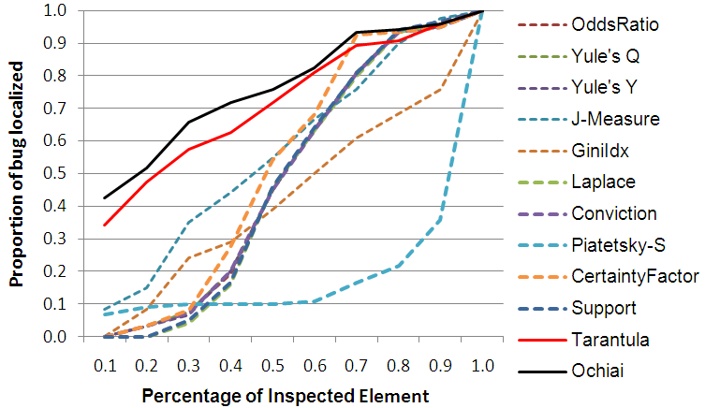
Some measures are not as good as Ochiai and Tarantula.

Slide 17
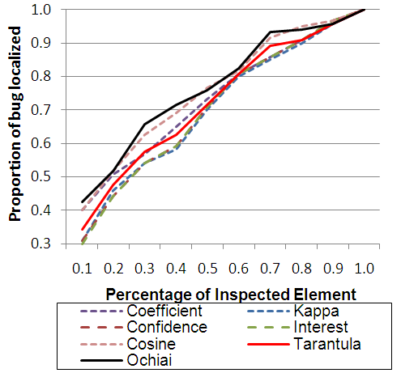
Some measures are comparable Ochiai and Tarantula.

Slide 18
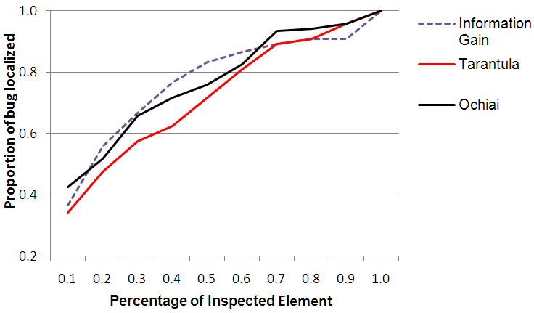
Improvement by Association Measure

Slide 19
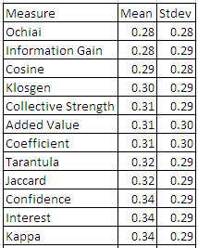
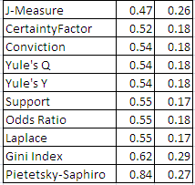
Percentage of Inspected Elements

Slide 20
The Statistical Significance between Measures
Coefficient, Kappa, Confidence, Interest, Cosine,
Added Value, Collective Strength , Jaccard, Klosgen,
Information Gain, Tarantula, Ochiai
J-Measure
Certainty Factor
Odd Ratio, Yule’s Q, Yule ‘s Y,
Support, Laplace, Conviction
Gini Index
Piatetsky-Shapiro

Slide 21
Summary of Findings
Fifty percent of the association measures have good accuracies for fault localization (28-34% inspected block)
Association measures that are statistically comparable with Ochiai and Tarantula are: Coefficient, Kappa, Confidence, Interest, Cosine , Added Value, Collective Strength, Jaccard, Klosgen, Information Gain
Information Gain can localize more bugs as compare to Ochiai when 20-50% blocks are
inspected.

Slide 22
Threats to Validity
The effect of different granularity of instrumentation level
(http://www.mysmu.edu/phdis2009/lucia.2009/Dataset.htm)
Dataset for experimentation is not a large program
Future Work
Investigate large real program
Investigate the effectiveness of the measures for different types of bug

Slide 23
THANK YOU

