Slide 1
ECON747: Spatial Econometric Models and Methods – Lab 5
Term I, 2026-2027
Yang Zhenlin
zlyang@smu.edu.sg
http://www.mysmu.edu/faculty/zlyang/

Slide 2
Analysis of FE-SPD with Matlab
The Zip folder “FE_SPD_App.zip” contains matlab files for analyzing the panel data set: Munnell:
SEDpanel_2way_application.m: for fitting SED model
SARpanel_2way_application.m: for fitting SLD model
SARARpanel_2way_application.m: for fitting SLE model
The data set can be replaced by cigarette, or fatality.
Each data set is associated with a readme file for a detailed description of the data
Spatial weight matrices corresponding to each of the three data sets are also given in the same folder.
Each main matlab file is associated with a subfunction that calculated the concentrated loglikelihood function.

Slide 3
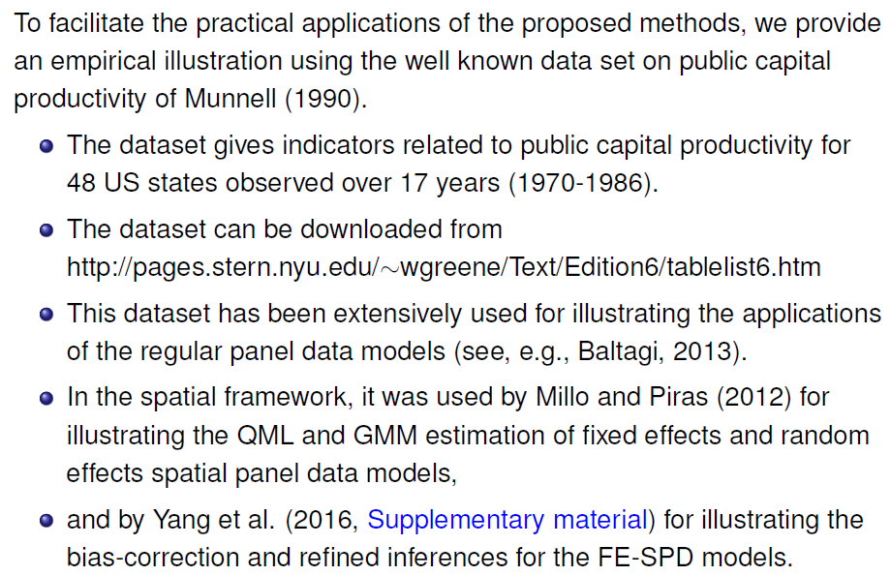
FE-SPD Model -- Public Capital Productivity

Slide 4
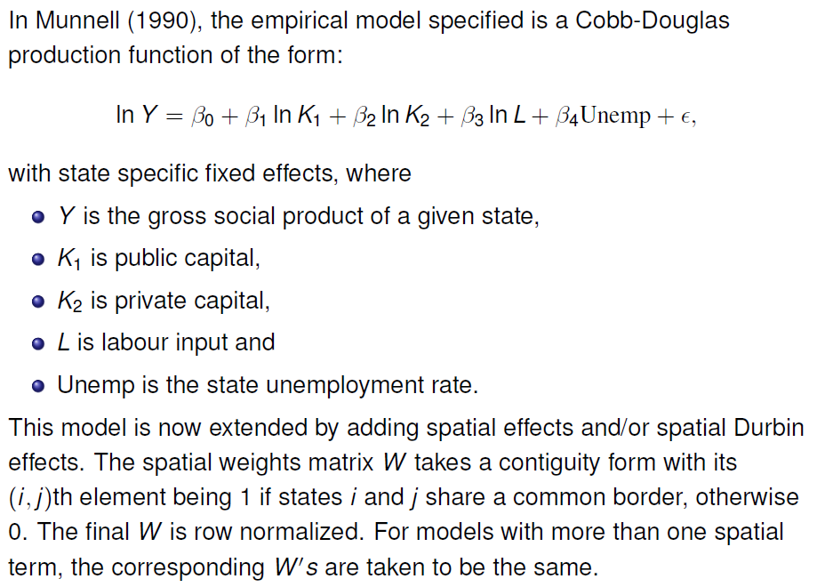
FE-SPD Model -- Public Capital Productivity

Slide 5
FE-SPD Model -- Public Capital Productivity
The Data (Munnell.xls):
Obs | State | Year | Y | K2 | K1 | L | Unemp
1 | 1 | 1970 | 4.45359 | 4.17704 | 4.55381 | 3.00454 | 4.7
2 | 4 | 1970 | 4.28529 | 4.00640 | 4.37265 | 2.73830 | 4.4
3 | 5 | 1970 | 4.18730 | 3.88157 | 4.29556 | 2.72933 | 5
4 | 6 | 1970 | 5.42149 | 5.10906 | 5.23752 | 3.84175 | 7.2
5 | 8 | 1970 | 4.40975 | 4.05700 | 4.37493 | 2.87518 | 4.4
6 | 9 | 1970 | 4.58973 | 4.20046 | 4.38170 | 3.07828 | 5.6
7 | 10 | 1970 | 3.83651 | 3.62849 | 3.78591 | 2.33606 | 4.8
8 | 12 | 1970 | 4.84286 | 4.47271 | 4.75723 | 3.33286 | 4.4
9 | 13 | 1970 | 4.63453 | 4.26175 | 4.61907 | 3.19243 | 4.1
10 | 16 | 1970 | 3.85582 | 3.53278 | 3.96389 | 2.31765 | 5.8
…

Slide 6
Fitting the SED Model
The main m-file, SEDpanel_2way_application.m: calls ‘Munnell.xls’ for data, ‘weight_Munnell.xls’ for W, ‘FnSED.m’ to obtain QMLE of ρ.
function rhoh = FnSED(T,Y,X,M,ev,lb0,ub0)
rhoh = fminbnd(@FnSed,lb0,ub0);
function f = FnSed(spa)
nt = length(Y);
n = nt/(T-1);
In = eye(n); It = eye(T-1);
B = In-spa*M;
Yr = kron(It,B)*Y; Xr = kron(It,B)*X;
XXr = Xr'*Xr; XXIr = pinv(XXr);
XY = Xr'*Yr;
bet = XXIr*XY;
eps = Yr-Xr*bet;
sig = eps'*eps/nt;
f = .5*log(sig)-sum(log(1-spa*ev))/n+log(1-spa)/n;
end
end

Slide 7
Fitting the SED Model
In the main file, the command
X = [X kron(IT,M)*X];
adds the Durbin terms to the model.
QMLE, Bias-Corrected QMLEs with Durbin-SED and 2Way-FE
Munnel
T = 17
IID Bootstrap
QMLE se t QMLE_bc se_bc t_bc
SED 0.4101 0.0436 9.4120 0.4175 0.0440 9.4860
LnK2 -0.0184 0.0268 -0.6867 -0.0183 0.0274 -0.6694
LnK1 0.1662 0.0272 6.1140 0.1662 0.0276 6.0140
LnL 0.7539 0.0294 25.6309 0.7539 0.0293 25.7055
Unemp -0.0009 0.0005 -1.7158 -0.0009 0.0005 -1.6978
WLnK2 -0.0750 0.0575 -1.3044 -0.0745 0.0571 -1.3057
WLnK1 0.0901 0.0594 1.5161 0.0897 0.0613 1.4638
WLnL -0.0130 0.0507 -0.2559 -0.0142 0.0508 -0.2789
Wunemp -0.0017 0.0010 -1.7525 -0.0017 0.0010 -1.7465
Elapsed time is 2.892787 seconds.

Slide 8
Fitting the SLD Model
The main m-file, SARpanel_2way_application.m: calls ‘Munnell.xls’ for data, ‘weight_Munnell.xls’ for W, ‘FnSAR.m’ to get QMLE of λ.
function rhoh = FnSAR(T,Y,X,XXI,W,ev,lb0,ub0)
rhoh = fminbnd(@FnSed,lb0,ub0);
function f = FnSed(rhoh)
nT = length(Y);
n = nT/(T-1);
In = eye(n);
It = eye(T-1);
A = In-rhoh*W;
AY = kron(It,A)*Y;
XAY = X'*AY;
bet = XXI*XAY;
eps = AY-X*bet;
sig = eps'*eps/nT;
f = .5*log(sig)+log(1-rhoh)/n-sum(log(1-rhoh*ev))/n;
end
end

Slide 9
Fitting the SLD Model
Simulation for QMLE, Bias-Corrected QMLEs with Durbin-SLD 2Way-FE
Munnel
T = 17
IID Bootstrap
QMLE se t QMLE_bc se_bc t_bc
SLD 0.4124 0.0433 9.5186 0.4231 0.0455 9.3059
LnK2 -0.0090 0.0262 -0.3420 -0.0088 0.0252 -0.3491
LnK1 0.1591 0.0266 5.9888 0.1591 0.0262 6.0686
LnL 0.7514 0.0299 25.1208 0.7515 0.0292 25.7202
Unemp -0.0006 0.0006 -1.1295 -0.0006 0.0006 -1.1287
WLnK2 -0.0567 0.0481 -1.1809 -0.0555 0.0464 -1.1954
WLnK1 0.0066 0.0476 0.1391 0.0039 0.0475 0.0826
WLmL -0.3159 0.0544 -5.8105 -0.3249 0.0555 -5.8513
WUnemp -0.0013 0.0008 -1.5365 -0.0013 0.0009 -1.4997
Elapsed time is 4.430700 seconds.

Slide 10
Fitting the SLE Model
The main file, SARARpanel_2way_application.m: calls ‘Munnell.xls’ for data, ‘weight_Munnell.xls’ for W, ‘FnSARAR.m’ to obtain QMLEs of λ and ρ.
QMLE, Bias-Corrected QMLEs with SLE 2Way-FE
Munnel
T = 17
IID Bootstrap
QMLE se t QMLE_bc se_bc t_bc
SLD 0.0270 0.0384 0.7036 0.0272 0.0367 0.7412
SED 0.4068 0.0536 7.5937 0.4112 0.0503 8.1684
LnK2 -0.0145 0.0258 -0.5599 -0.0143 0.0258 -0.5545
LnK1 0.1553 0.0265 5.8638 0.1553 0.0273 5.6805
LnL 0.7555 0.0294 25.7262 0.7555 0.0296 25.4833
Unemp -0.0012 0.0005 -2.3652 -0.0012 0.0005 -2.3577
Elapsed time is 7.288321 seconds.

Slide 11
Fitting the SLE Model
In the main files, e.g., in ‘SARARpanel_2way_application.m’, change the part below for fitting models with only individual-specific effects by defining:
FnTN= kron(FT,In);
==========================================================
…
% transform variables based on two-way fixed effects
% (change to give individual-specific effects only)
Jt = IT-jt*jt'/T; [V1,D1] = eig(Jt); FT = V1(:,2:end);
Jn = In-jn*jn'/n; [V2,D2] = eig(Jn); FN = V2(:,2:end);
FnTN= kron(FT,FN); % for two-way fixed effects
Ytr = FnTN'*Y; Xtr = FnTN'*X;
Wtr = FN'*W*FN; WT = kron(It, Wtr);
Mtr = Wtr; MT = kron(It, Mtr);
MM = Mtr'*Mtr;
…

