Slide 1
ECON747: Spatial Econometric Models and Methods – Lab 1
Term I, 2026-2027
Yang Zhenlin
zlyang@smu.edu.sg
http://www.mysmu.edu/faculty/zlyang/

Slide 2
Software and Installation
Matlab: SMU network licensed, request through school.
Contact: THOR Qiu Ling qlthor@smu.edu.sg
STATA: SMU network licensed, request through school.
Contact: THOR Qiu Ling qlthor@smu.edu.sg
Python: A high-level, general-purpose programming language. It is a free and open-source programming language, available for everyone to use.
See slides ‘Python4ML&DS’ for details.
R: A popular programming language, especially in certain fields such as data science, academic research, and statistics.
Visit https://www.r-project.org/ for installation.
Lab 1 is the first Matlab application for spatial linear regression.

Slide 3
Neighborhood Crime Data - Matlab
In illustrating the applications of spatial cross-sectional models, Anselin (1988, p.187) used the neighborhood crime data corresponding to 49 contiguous neighborhood in Columbus, Ohio, in 1980. These neighborhood correspond to census tracts, or aggregates of a small number of census tracts, where
Crime: the combined total of residential burglaries and vehicle thefts per thousand household in the neighborhood (the response variable).
Income and House: the explanatory variables representing income and housing values in thousand dollars.
East: a dummy variable indicates whether the `neighborhood' in the east or west of a main north-south transportation axis.
In addition, the neighborhood centroid coordinates are also given, as well as the list of neighbors of each spatial unit (neighborhood) that gives a first-order contiguity spatial weight matrix.
Model: Crime = β₀ + β₁Income + β₂House + error + spatial terms

Slide 4
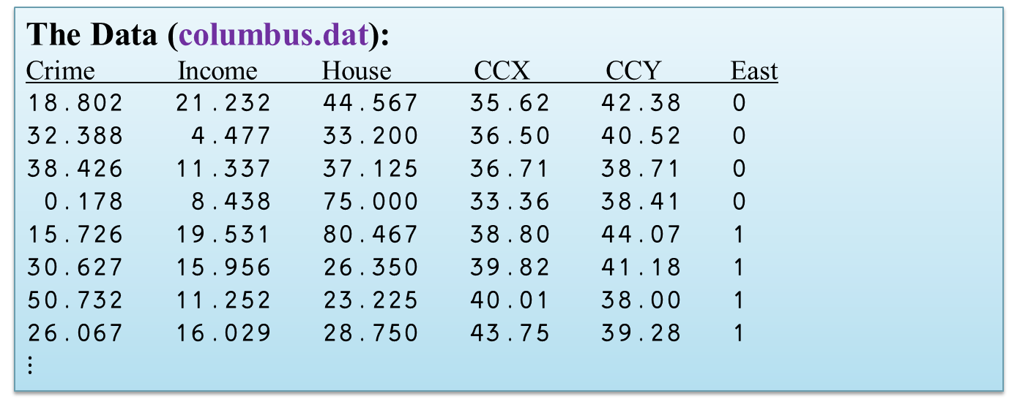
Neighborhood Crime Data
The Data (columbus.dat):
Crime Income House CCX CCY East
18.802 21.232 44.567 35.62 42.38 0
32.388 4.477 33.200 36.50 40.52 0
38.426 11.337 37.125 36.71 38.71 0
0.178 8.438 75.000 33.36 38.41 0
15.726 19.531 80.467 38.80 44.07 1
30.627 15.956 26.350 39.82 41.18 1
50.732 11.252 23.225 40.01 38.00 1
26.067 16.029 28.750 43.75 39.28 1
$$⋮$$
The Spatial Weight Matrix W (wmat.dat):
The spatial weight matrix for the crime data is the 1st order contiguity matrix, stored in sparse matrix format [i, j, s] = find(W), so that the Matlab statement, W = sparse(i,j,s), reconstructs the 49×49 spatial weight matrix.
W is already row-standardized.

Slide 5
Fitting Crime Data with SED Model
The generic m-function SED_ML.m, called by the main program Columbus_Qmle_SED.m, is for maximizing the concentrated log-likelihood function given in (2.8), Chap 2 lecture notes. It returns (Q)MLE of ρ.
function rhoh = SED_ML(y,x,W)
rhoh = fminsearch(@FnSLDh2,0);
function f = FnSLDh2(rhoh)
n = length(y);
In = eye(n);
B = In − rhoh*W;
By = B*y;
Bx = B*x;
beth = pinv(Bx'*Bx)*Bx'*By;
eps = By − Bx*beth;
sig2 = eps'*eps/n;
f = .5*log(sig2) − log(det(B))/n;
end
end

Slide 6
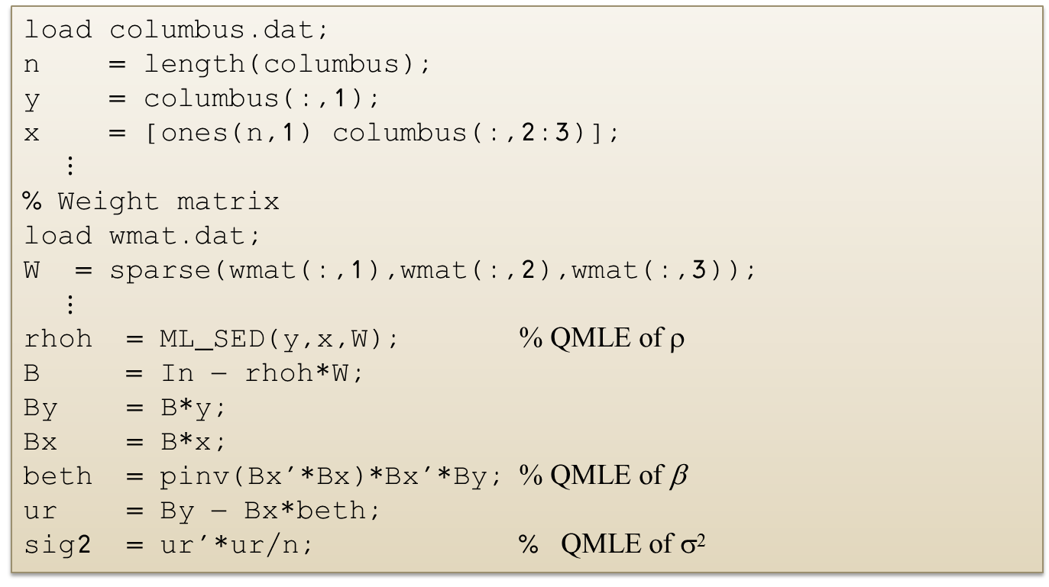
Fitting Crime Data with SED Model
The main m-file, Columbus_Qmle_SED.m: for QML estimation and inference for SED model, using the neighborhood crime data.
load columbus.dat;
n = length(columbus);
y = columbus(:,1);
x = [ones(n,1) columbus(:,2:3)];
$$⋮$$
% Weight matrix
load wmat.dat;
W = sparse(wmat(:,1),wmat(:,2),wmat(:,3));
$$⋮$$
rhoh = ML_SED(y,x,W); % QMLE of ρ
B = In − rhoh*W;
By = B*y;
Bx = B*x;
beth = pinv(Bx'*Bx)*Bx'*By; % QMLE of β
ur = By − Bx*beth;
sig2 = ur'*ur/n; % QMLE of σ²

Slide 7
Fitting Crime Data with SED Model
The results for QML estimation:
(Q)MLE se_MLE t_MLE se_QMLE t_QMLE
β₀ 59.8924 5.3662 11.1611 5.3662 11.1611
β₁ -0.9413 0.3306 -2.8477 0.3306 -2.8477
β₂ -0.3023 0.0905 -3.3407 0.0905 -3.3407
ρ 0.5618 0.1339 4.1963 0.1343 4.1835
σ² 95.5737 19.8735 4.8091 27.1596 3.5190
The results for OLS and GLS-GM estimation:
OLSE t_OLSE GLS-GM t_GLS-GM
β₀ 68.6189 3.0600 ? ?
β₁ -1.5973 -14.3073 ? ?
β₂ -0.2739 -25.7215 ? ?
ρ ? ?
σ² 130.7577 ~ ? ?

Slide 8
Fitting crime data with SLD model
The generic m-function SLD_ML.m, called by the main program Columbus_Qmle_SLD.m, is for maximizing the concentrated log-likelihood function given in (2.19), Chap 2 lecture notes, returning (Q)MLE of λ.
Function lamh = SLD_ML(y,x,W)
lamh = fminsearch(@FnSLDh2,0);
function f = FnSLDh2(lamh)
n = length(y);
In = eye(n);
A = In − lamh*W;
Ay = A*y;
xAy = x'*Ay;
beth = pinv(x'*x)*xAy;
eps = Ay − x*beth;
sig2 = eps'*eps/n;
f = .5*log(sig2) − log(det(A))/n;
end
end

Slide 9
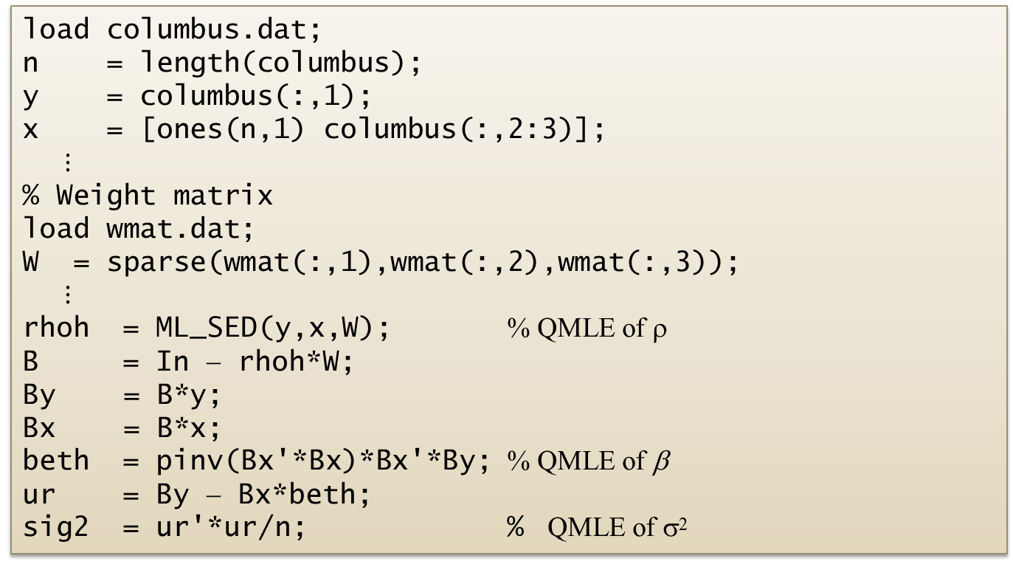
Fitting crime data with SLD model
The main m-file, Columbus_Qmle_SLD.m: for QML estimation and inference for SLD model, using the neighborhood crime data.
load columbus.dat;
n = length(columbus);
y = columbus(:,1);
x = [ones(n,1) columbus(:,2:3)];
$$⋮$$
% Weight matrix
load wmat.dat;
W = sparse(wmat(:,1),wmat(:,2),wmat(:,3));
$$⋮$$
rhoh = ML_SED(y,x,W); % QMLE of ρ
B = In − rhoh*W;
By = B*y;
Bx = B*x;
beth = pinv(Bx'*Bx)*Bx'*By; % QMLE of β
ur = By − Bx*beth;
sig2 = ur'*ur/n; % QMLE of σ²

Slide 10
Fitting crime data with SLD model
The results for QML estimation:
(Q)MLE se_MLE t_MLE se_QMLE t_QMLE
β₀ 45.0781 7.1773 6.2807 7.1633 6.2929
β₁ -1.0316 0.3051 -3.3806 0.3042 -3.3909
β₂ -0.2659 0.0885 -3.0049 0.0885 -3.0049
ρ 0.4310 0.1177 3.6629 0.1182 3.6453
σ² 95.4875 19.4864 4.9002 30.5713 3.1234
The results for OLS and GMM estimation:
OLSE se_OLSE t_OLSE GMM se_GMM t_GMM
β₀ 38.1810 84.9013 4.1437
β₁ -0.8658 0.1263 -2.4362
β₂ -0.2636 0.0083 -2.8853
ρ 0.5573 0.0226 3.7090
σ² 102.3684 ~

Slide 11
Fitting crime data with SLE model
The generic m-function SLE_ML.m, called by the main program Columbus_Qmle_SLE.m, is for maximizing the concentrated log-likelihood given in (2.30), Chap 2 lecture notes, returning (Q)MLEs of λ and ρ.
function spa = SLE_ML(y,x,W)
spa = fminsearch(@FnSLDh2,[0,0]);
function f = FnSLDh2(spa)
n = length(y);
In = eye(n);
A = In − spa(1)*W;
B = In − spa(2)*W;
Bx = B*x;
beth = pinv(Bx'*Bx)* Bx'* B*A*y;
eps = B*A*y − Bx*beth;
sig2 = eps'*eps/n;
f = .5*log(sig2) − log(det(A))/n − log(det(B))/n;
end
end

Slide 12
Fitting crime data with SLE model
In the main program Columbus_Qmle_SLE.m , the key commands are:
spah = SLE_ML(y,x,W); % QMLE of lambda and rho
A = In − spah(1)*W;
B = In − spah(2)*W;
The results for QML estimation:
(Q)MLE se_MLE t_MLE se_QMLE t_QMLE
β₀ 47.7796 9.9011 4.8257 9.9112 4.8208
β₁ -1.0258 0.3263 -3.1437 0.3257 -3.1495
β₂ -0.2816 0.0900 -3.1283 0.0900 -3.1282
σ² 95.5976 19.4737 4.9091 30.1696 3.1687
λ 0.3681 0.1966 1.8725 0.1975 1.8635
ρ 0.1666 0.2966 0.5616 0.2968 0.5612

