Slide 1
Aligning Course Competencies using Text Analytics
Dr. Swapna Gottipati
Assistant Professor (Education)
School of Information Systems
Singapore Management University

Slide 2
Introduction
“College standards are becoming diluted and there is a fuzziness about what faculty teach and what is expected from students.”
(Miller & Malandra, 2006, p. 3/
Commission on the Future of Higher Education)
Notes:
Communicating Curriculum Intentionality – Curriculum Purpose and Goals
Transparency and clarity of intended learning outcomes and the curriculum that advances these outcomes become increasingly critical for accountability purposes
Structures of current curricula often resemble mazes; often, not only students but experienced professors-advisors experience difficulties in progressing through curricula.
Structure and purposes of the curriculum should be transparent, explicit, easy to demonstrate, and easy to understand, and easy to navigate

Slide 3
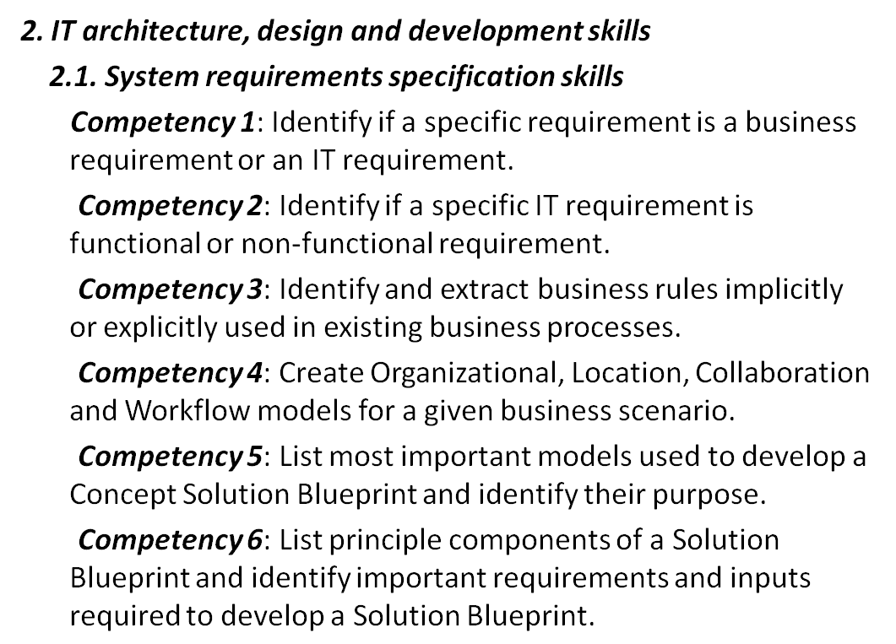
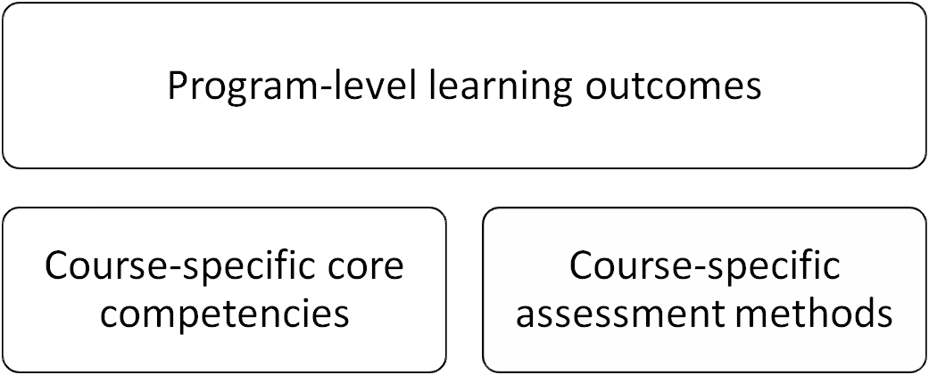
Background
Labs
Project
Assignments
Exams
Case studies
Quizzes
Competency
  an intended effect of the educational program experiences that has been stated
  specific, observable, and measurable
  E.g: “Create and evaluate the business process model for a given real world scenario”
Assessment
  should be tailored to a specific competency and should be reliable, valid and fair for that

Slide 4
What is Course Alignment?
Learning objectives: What do I want students to know how to do when they leave this course?
Assessments: What kinds of tasks will reveal whether students have achieved the learning objectives I have identified?
Course Evaluation
Competencies
Assessments
Teaching activities
Instructional activities: What kinds of activities in and out of class will reinforce the learning objectives and prepare students for assessments?
We focus on aligning the competencies and assessments in this talk.
Notes:
Curriculum Alignment is an iterative process involving systematic study (curriculum mapping, analysis, and interpretation) of curricular components to determine the degree of consistency between what faculty expect students to learn, what faculty think they teach, and what students learn as a result of their educational experiences. Curriculum Alignment ensures that
Faculty teach what they claim they teach
Student learn what they are supposed to learn
English (1978) described the “fictional curriculum”. This is the declared curriculum – what it is assumed the student is learning. This may different from the ‘real” or taught curriculum – that is, the curriculum as it is delivered to the student. It may also be different from the “learned” or “tested” curriculum – what students actually learn.
In a perfect, ideal world, these three circles will be perfectly aligned, that is there will be one circle.
Curriculum Intentionality is a deliberate and systematic alignment of intended program learning outcomes with course-level pedagogies and instructional and learning activities.
Three Intentionality questions:
“Are we teaching what is being tested”? (opportunities to learn)
“Is what we are teaching being tested?” (Content coverage)
“Does assessment measure student progress in achieving intended learning outcomes?” (content validity)
Teaching
Includes the topics that are taught together with the delivery activities.
We also assume that the topics are embedded in the competencies. For example

Slide 5
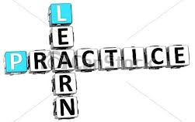

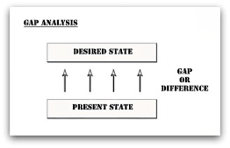
Why is it important?
Enabling teachers to provide students with the
opportunities for learn and practice
Enabling students to focus their efforts on activities for “good grades” which are more likely to translate into “good learning”.
Suggesting assessment questions to the teaching staff.
Discovering the gaps in the overall
curriculum.
Notes:
First, alignment increases the probability that teachers will provide students with the opportunities to learn and practice the knowledge and skills that will be required on the various assessments they design.
Second, when assessments and objectives are aligned, “good grades” are more likely to translate into “good learning”. When objectives and assessments are misaligned, many students will focus their efforts on activities that will lead to good grades on assessments, rather than focusing their efforts on learning what teaching staff believe is important.
Third, alignment can aid in suggesting assessment questions to the teaching staff.
Fourth, misalignment can aid teaching staff in the redefining the course competencies or redesigning the assessments. It also aids to discover the gaps in the overall curriculum.

Slide 6
Agenda
Motivation
Challenges
Solution
Evaluations
Conclusions

Slide 7
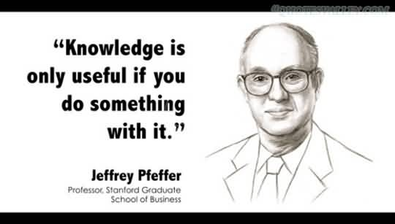

Motivation
Academic success = what students remember + + students are able to do with their knowledge.
Alignment is a way of evaluating the course components.
We need a alignment models (methodology) to measure the alignment.
ALIGNING TEACHING AND ASSESSING TO COURSE OBJECTIVES, John Biggs

Slide 8
Current Alignment Models
Model | Key Features | Review and Analysis Time | Training Time
Webb | 1. Qualitative ratings 2. Quantitative results | 1 day per team and match items, depth of knowledge (Multiple grades); 1 month turnaround for analysis and report. | ½ day to train reviewers
SEC | 1. Content matrix 2. Measure of alignment highly predictive of student achievement scores | 1 day per team for coding items and benchmarks in matrix; ½ day for readers to complete survey on instruction; 1 week for analysis and report | ½ day to train reviewers
Achieve | 1. Reviewers need to make inferences 2. In-depth review | Alignment review takes 1 day per test; Report and analysis takes 1 – 1½ months. | Has pool of highly trained reviewers
Manual, Slow, Resource intense, Not scalable

Slide 9
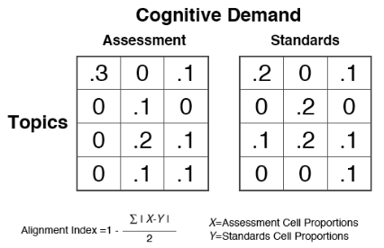
Porter Model
Alignment is perfect if the proportions for the assessment match cell by cell the proportions for the standards.
Competencies
We need automated methods that leverage the existing alignment models.

Slide 10

Goal: How to align the competencies and assessments?
Analyse the assessment wrt to the competencies.
Analyse assessments of the course to find missing gaps or useful patterns.
Measure alignment between the assessments and competencies quantitatively.

Slide 11

Challenges
Assessments and Competencies are textual in nature
Topics are not explicitly specified in any of the documents
Manual discovery of the topics and cognition is expensive and burdensome
To construct the competency-cognitive and assessment-cognitive matrices, we need a principled method that can automatically;
Extract topics from the documents.
Extract the cognition domains for each topic from both competencies and assessments

Slide 12

Solution Motivation
Levels of skills can be discovered with the standard cognitive domain of Bloom’s taxonomy.
Porter’s alignment model uses topics, standards (competencies) and assessments on the cognitive domain to discover alignment.
Keyphrase extraction models are the means to extract the important terms or topics from the documents.
Sensitivity Alignment Score that uses sensitivity measure, also known as true positive rate. Given the list of topics and the cognitive competencies, we measure to what extent the assessments test the topics at the cognitive levels of competencies.
Notes:
In information systems, the assessments can may focus more on the higher cognitive levels such as application, analysis, evaluation and synthesis. So, Porter’s model may not be an appropriate tool for the measurement. Hence, we propose a

Slide 13
Competency-Assessment Cube
Learning
Outcomes
(Subsumes competencies)
Integration Skills
Design and development skills
Topics
Management skills
Learning to learn skills
Collaboration skills
Change management skills
Synthesis
Global Skills
Social Skills
Evaluation
Labs
Analysis
Projects
Application
Topics
Quiz
Comprehension
Exam
Knowledge
Case studies
Cognitive taxonomy
Assignments
Assessments

Slide 14
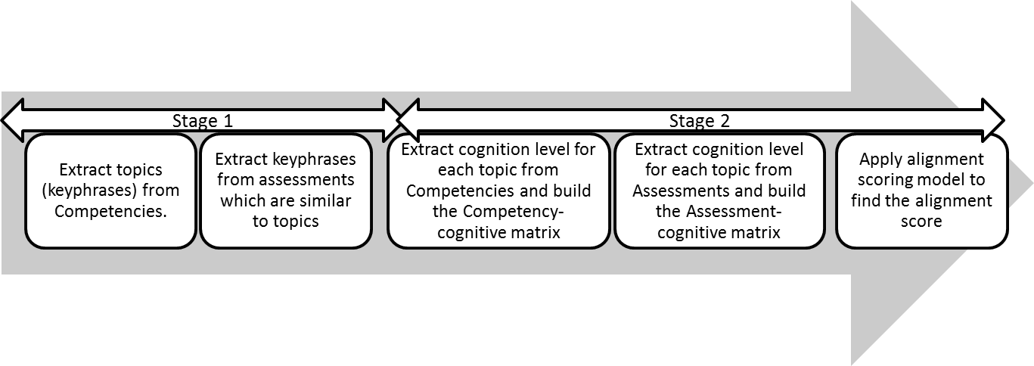
Solution
Topic (Competency phrase) | Assessment Phrase
to-be option | to-be scenario
to-be analysis | path analysis
organizational business process | as-is process
0.2 | 0.1 | 0.0 | 0.3
0.0 | 0.0 | 0.3 | 0.2
0.2 | 0.2 | 0.3 | 0.1
0.3 | 0.1 | 0.1 | 0.0
0.3 | 0.0 | 0.0 | 0.2
0.1 | 0.1 | 0.3 | 0.2
0.1 | 0.2 | 0.3 | 0.1
0.2 | 0.1 | 0.2 | 0.1
C₁
C₁
C₁
C₁
C₁
C₁
C₁
C₁
T₁
T₁
0.93
T₂
T₂
T₃
T₃
T₄
T₄

Slide 15
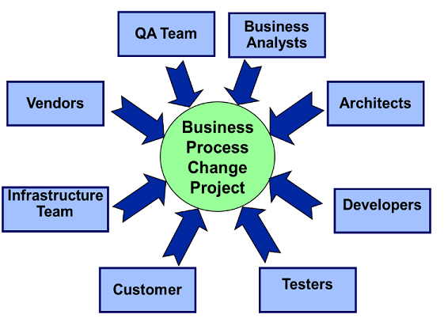
Evaluations
School of Information System’s undergraduate course - Process Modeling and Solution Blueprinting
Competencies – 62
Assessments – 4 labs, assignment, project & exam

Slide 16
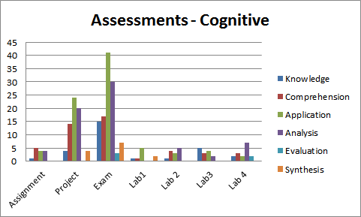
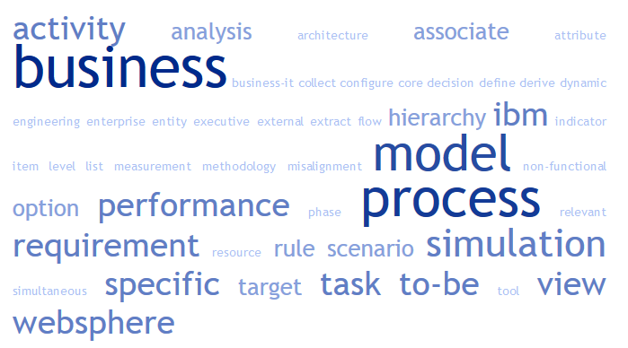
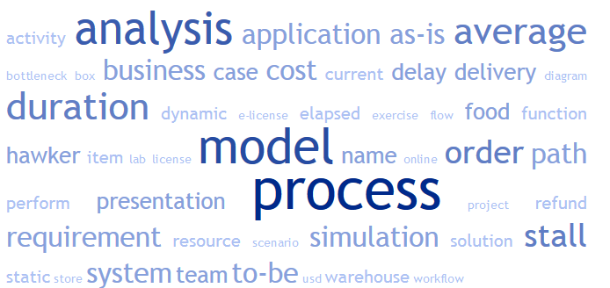
Data Analysis
Competency Analysis by Cognitive Levels
Assessments Analysis by Cognitive Levels
Word cloud for the competency phrases
Word cloud for the assessment phrases

Slide 17
Data Analysis
Topics
Competencies
Assessments
application model
as-is process
associate cost
associate task
Analysis | Application | Comprehension | Evaluation | Knowledge | Synthesis
0.00 | 0.02 | 0.00 | 0.00 | 0.00 | 0.00
0.00 | 0.00 | 0.00 | 0.00 | 0.01 | 0.00
0.00 | 0.03 | 0.02 | 0.00 | 0.00 | 0.00
0.00 | 0.03 | 0.02 | 0.00 | 0.00 | 0.00
Analysis | Application | Comprehension | Evaluation | Knowledge | Synthesis
0.00 | 0.01 | 0.01 | 0.00 | 0.00 | 0.00
0.02 | 0.02 | 0.02 | 0.00 | 0.01 | 0.01
0.00 | 0.00 | 0.00 | 0.00 | 0.00 | 0.00
0.00 | 0.00 | 0.00 | 0.00 | 0.00 | 0.00
Porter’s alignment tables for 4 sample topics in our dataset.

Slide 18
Results - Stage1 (Keyphrase Extraction)
Phrases | Count
Competency Phrases (Topics) | 55
Assessment Phrases | 258
Assessment Phrases similar to topics | 57
Table1: Statistics of the topics, competencies and assessments
Topic | Assessment Phrase
to-be option | to-be scenario
to-be analysis | path analysis
organizational business process | as-is process
Table2: Example topic and corresponding assessment phrase.
These phrases might exist in multiple assessments (labs, projects etc).

Slide 19
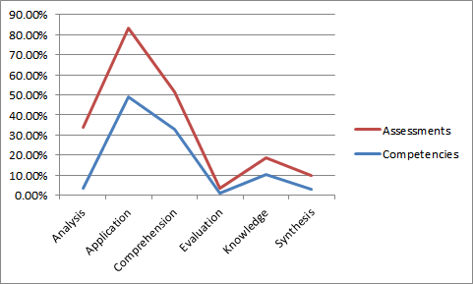
Results - Stage2 (Alignment)
Alignment Results
  The cognitive distribution of competencies and assessments is similar.

Slide 20
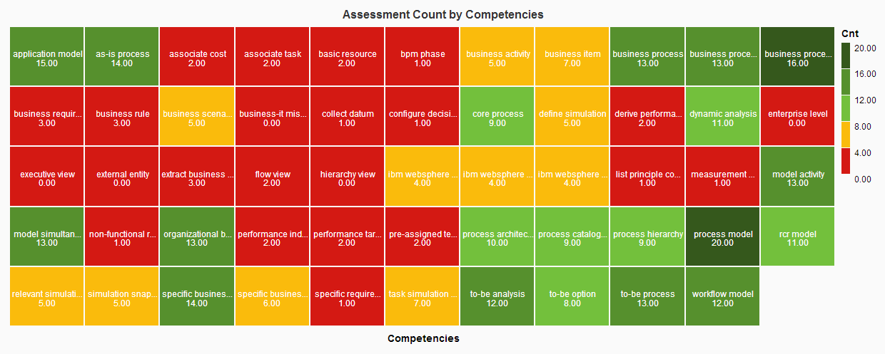
Results– Gaps & Insights
Analyse assessments of the course to find missing gaps or useful patterns.
The above heatmap shows which topics are assessed and to what extent.
Notes:
Competencies for topics such as executive view, external entity are at very low level where as as-is process, workflow are above average and process model, business process are at the highest. Can improve this graph for better view.

Slide 21
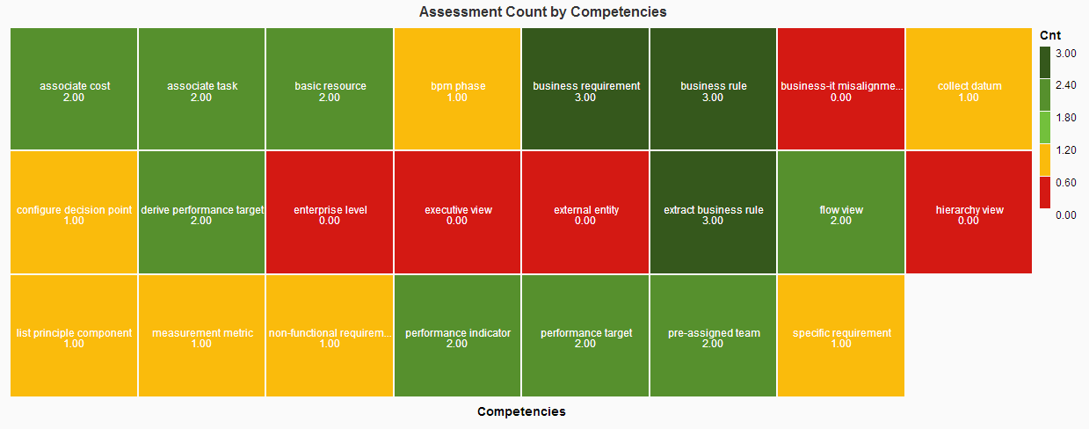
Results - Gaps & Insights
Assessment rates for topics such as executive view, external entity are at very low level.

Slide 22
Results – Alignment Score
Alignment Score
  Sensitivity alignment score is 90.8%.
  Indicates that assessments are highly aligned with the competencies.

Slide 23
Results - Analysis
1. Misalignment - Improve the competency definitions
Topics (Competency Phrases) missing in assessments
business-it misalignment
enterprise level
executive view
hierarchy view
Example topics which are missing in the assessments
The above topics are not aligned and therefore the competencies can be redefined.

Slide 24
Results - Analysis
2. Misalignment - Recommend Questions to the Instructor
Topic | Missing Assessments
business activity | Analysis , Comprehension
business-it misalignment | Comprehension
enterprise level | Application, Knowledge
executive view | Application, Knowledge
hierarchy view | Application, Knowledge
Example topics and missing assessments at cognitive levels
The above topics are not tested (assessments) and can be suggested to the teaching staff.
Notes:
Example topics and missing assessments at cognitive levels

Slide 25
Conclusions
Some topics/keyphrases are noisy or non-coherent. Topics can be improved with external knowledge such as Wiki.
Alignment analysis is incomplete without understanding the teaching activities.
Our alignment model can be applied at the program level to measure the overall curriculum alignment.

Slide 26
Thank you for your kind attention.
http://www.mysmu.edu/faculty/swapnag/

