Slide 1
Generating Templates of Entity Summaries with an Entity-Aspect Model and Pattern Mining
Peng Li, Jing Jiang, Yinglin Wang
Shanghai Jiao Tong University
Singapore Management University

Slide 2
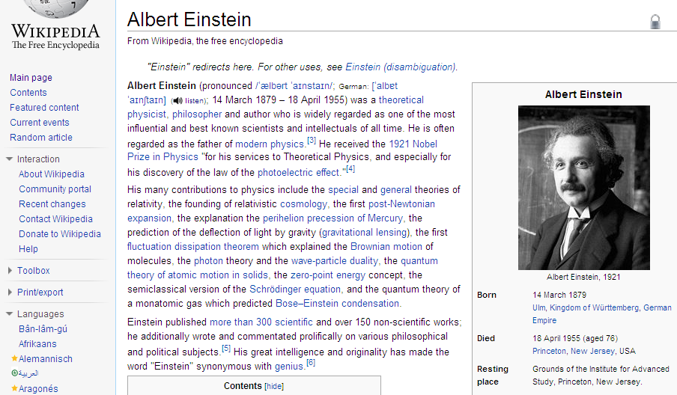
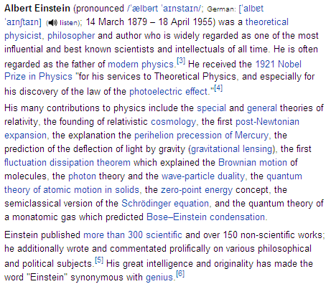
An Example Entity Summary

Slide 3
An Example Entity Summary
… received … Nobel Prize …
His … contributions … include …
… published … works …

Slide 4
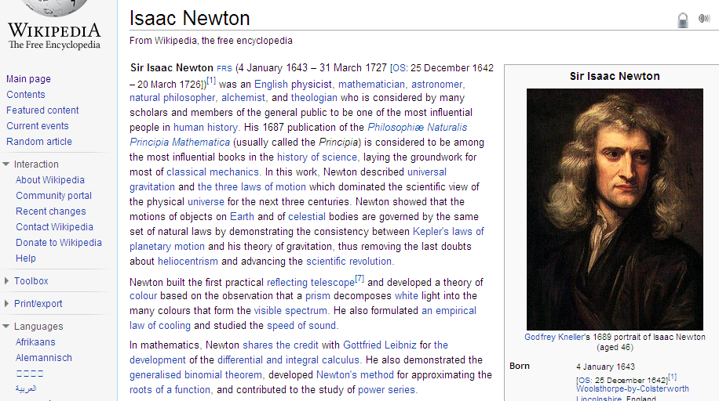
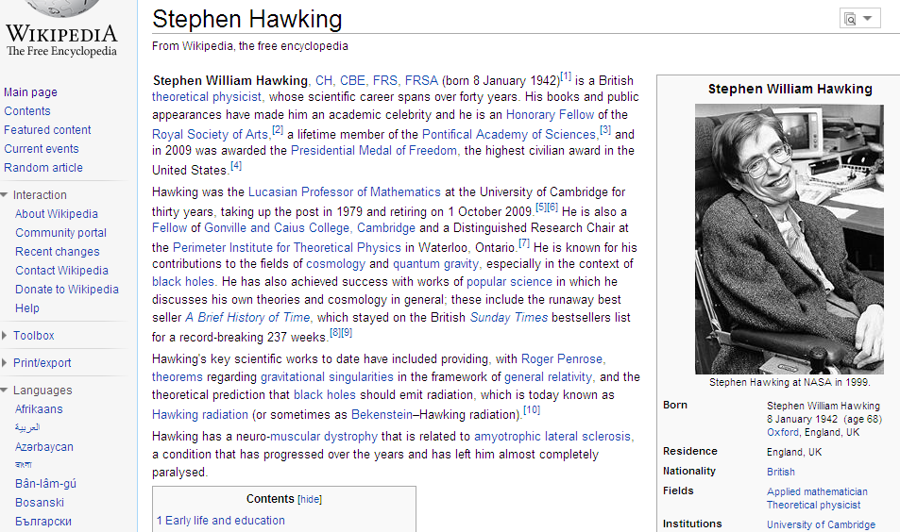
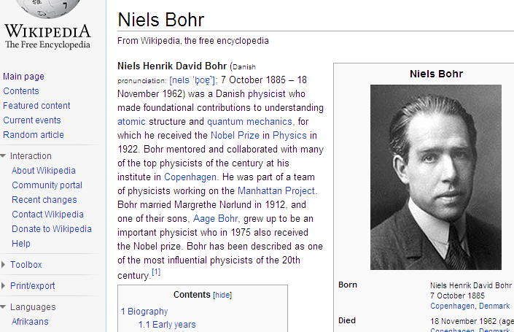
Entity Summaries in the Same Category

Slide 5
Entity Summaries in the Same Category
Aspect | Representative Sentence Patterns
Education | X received his PhD from ___ University X studied ___ under ___ X earned his ___ in physics from University of ___
Awards | X was awarded the medal in ___ X won the ___ award X received the Nobel Prize in physics in ___
Career | X was ___ director X was the head of ___ X worked for ___
Contributions | X made contributions to ___ X is best known for work on ___ X is noted for ___
Our task is to automatically generate such entity summary templates.

Slide 6
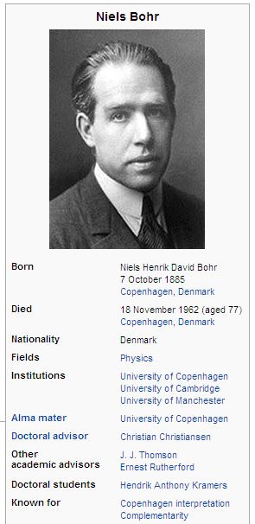
Why Is It Useful?
Better organizes information units
Wikipedia infoboxes
Provides a structured template for humans to create new entity summaries
Facilitates automatic entity summary generation

Slide 7
Outline
Task and motivation
Related work
Our approach
Sentence clustering
Pattern mining
Evaluation
Conclusions

Slide 8
Related Work
Filatova et al. (2006) “Automatic creation of domain templates”
Patterns must contain a non-auxiliary verb
Patterns are not clustered into aspects
Pattern slots are identified through heuristics
Sauper & Barzilay (2009) “Automatically generating Wikipedia articles”
Long, comprehensive articles
LDA extensions
Chemudugunta et al. (2007)
Titov & McDonald (2008)
Daume III & Marcu (2006), Haghi & Vanderwende (2009)

Slide 9
Outline
Task and motivation
Related work
Our approach
Sentence clustering
Pattern mining
Evaluation
Conclusions

Slide 10
Overview of Our Approach
Physicist
sentence clustering
pattern mining
1. ENT won the ? award
2. ENT …
1. ENT … …
2. ENT …
1. ENT … …
2. ENT …
1. ENT received his PhD from ? University
2. ENT …

Slide 11
Outline
Task and motivation
Related work
Our approach
Sentence clustering
Pattern mining
Evaluation
Conclusions

Slide 12
Sentence Clustering
To group sentences related to the same aspect together
To distinguish between aspect words and entity-specific words
… graduated from the University of Chicago
???
aspect word
aspect word
entity-specific word

Slide 13
Motivating Example
… … Venturi was a professor of physics at the University of Modena … …
… … He was a professor of physics at the University of Chicago until 1982 … …

Slide 14
Motivating Example
… … Venturi was a professor of physics at the University of Modena … …
… … He was a professor of physics at the University of Chicago until 1982 … …

Slide 15
Motivating Example
… … Venturi was a professor of physics at the University of Modena … …
venturi
…
…
modena
Venturi
… … He was a professor of physics at the University of Chicago until 1982 … …
chicago
…
1982
Anderson

Slide 16
Motivating Example
… … Venturi was a professor of physics at the University of Modena … …
venturi
…
…
modena
Venturi
… … He was a professor of physics at the University of Chicago until 1982 … …
chicago
…
1982
physics
Anderson
physicist
…
…
research
background

Slide 17
Motivating Example
… … Venturi was a professor of physics at the University of Modena … …
professor
venturi
…
…
institute
…
modena
…
university
Venturi
affiliation
… … He was a professor of physics at the University of Chicago until 1982 … …
chicago
…
1982
physics
Anderson
physicist
…
…
research
background

Slide 18
Motivating Example
… … Venturi was a professor of physics at the University of Modena … …
professor
venturi
…
…
institute
…
modena
…
university
Venturi
affiliation
award
won
…
… … He was a professor of physics at the University of Chicago until 1982 … …
…
prize
chicago
…
award
1982
physics
Anderson
physicist
…
…
research
background

Slide 19
Motivating Example
… … Venturi was a professor of physics at the University of Modena … …
ψ¹
φ¹
D₁
A₁
φ²
… … He was a professor of physics at the University of Chicago until 1982 … …
ψ²
A₂
φ^{B}
D₂
background

Slide 20
Entity-Aspect Model
D
N_{d}
y Є {1, 2, 3}
z Є {1, …, A}
ψ^{d}
?
w
y
z
?
?
A
?
φª
φ^{B}
π
θ

Slide 21
Entity-Aspect Model
D
S_{d}
N_{d,s}
y Є {1, 2, 3}
z Є {1, …, A}
ψ^{d}
w
y
z
A
φª
φ^{B}
π
θ
β
γ
α

Slide 22
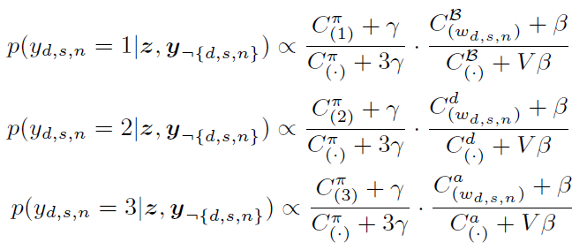
Model Inference
Gibbs sampling

Slide 23
Clustered Sentences
Venturi/D was/S a/S professor/A of/S physics/B at/S the/S University/A of/S Modena/D ./S
He/S was/S a/S professor/A of/S physics/B at/S the/S University/A of/S Chicago/D until/S 1982/D ./S
… …
S: stop word
B: background word
A: aspect word
D: document word

Slide 24
Outline
Task and motivation
Related work
Our approach
Sentence clustering
Pattern mining
Evaluation
Conclusions

Slide 25
Pattern Mining
Use heuristics to locate subject entities
Title of the Wikipedia article
Top 3 frequent subject noun phrases in the article
Generate labeled dependency parse trees
Replace document words with “?”
Mine frequent subtree patterns
Prune patterns
Remove patterns with no subject entity
Remove patterns with no aspect word
Convert subtree patterns to sentence patterns

Slide 26
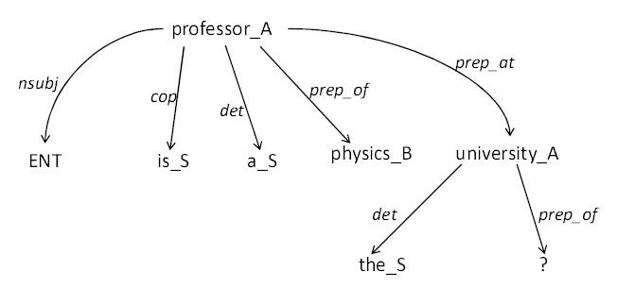
A Labeled Dependency Parse Tree

Slide 27
Sample Aspects and Patterns
Aspect | Sample Sentence Patterns
1 | X received his PhD from ___ University X studied ___ under ___ X earned his ___ in physics from University of ___
2 | X was awarded the medal in ___ X won the ___ award X received the Nobel Prize in physics in ___
3 | X was ___ director X was the head of ___ X worked for ___
4 | X made contributions to ___ X is best known for work on ___ X is noted for ___

Slide 28
Outline
Task and motivation
Related work
Our approach
Sentence clustering
Pattern mining
Evaluation
Conclusions

Slide 29
Data Set
Wikipedia articles from 5 categories
Category | Documents | Sentences | Avg Sent/Doc
US Actress | 407 | 1721 | 4
Physicist | 697 | 4238 | 6
US CEO | 179 | 1040 | 5
US Company | 375 | 2477 | 6
Restaurant | 152 | 1195 | 7

Slide 30
Quantitative Evaluation
Sentence patterns
Manually judged whether each sentence pattern is meaningful for the given entity category
Allows us to compute precision, recall and f1
Baseline 1: pattern mining without entity-aspect model
Baseline 2: verb-based pruning (Filatova et al. 2006) on top of BL-1
Aspect clusters
Manually grouped meaningful patterns into clusters
Allows us to compute purity

Slide 31
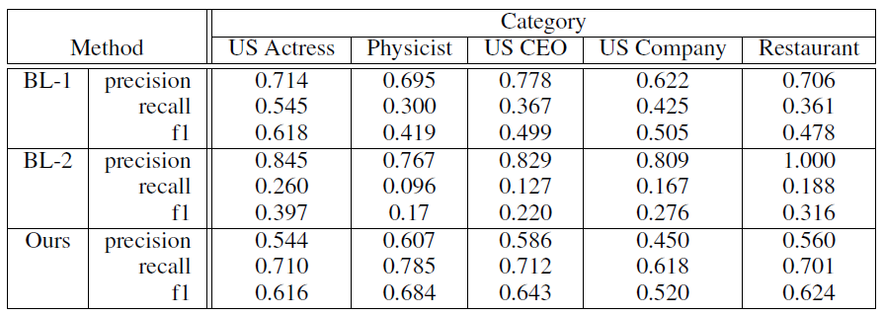
Quality of Sentence Patterns
No consideration of aspect clusters.
High precision of BL-1 and BL-2: They use a higher frequency threshold to select frequent sentence patterns.
Low recall of BL-2: Many meaningful sentence patterns do not contain a non-auxiliary verb.
BL-1 and BL-2 do not generate template slots.

Slide 32
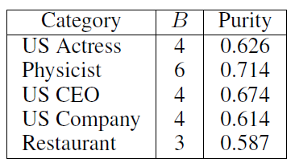
Quality of Aspect Clusters

Slide 33
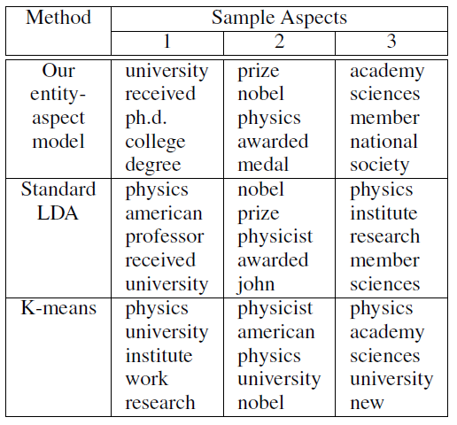
Sample Aspects and Their Representative Words

Slide 34
Conclusions
We proposed an LDA-based entity-aspect model to simultaneously cluster sentences and label words
We used pattern mining to identify sentence patterns with slots
We empirically evaluated our method and showed its effectiveness

Slide 35
Future Directions
Use linguistic knowledge to further prune sentence patterns and improve their readability
Automatic aspect labeling
Automatic entity summary generation

Slide 36
Thank You!

