Slide 1
Comments on
“Asset Bubbles and Bailouts”
By Tomohiro Hirano, Masaru Inaba, and Noriyuki Yanagawa
Haiping Zhang
Singapore Management University
Young Researchers Seminar, ADBI, Tokyo
28 August 2013

Slide 2
Related Literature
Rational bubbles and investment
The crowd-out effect and dynamic inefficiency
Tirole (1985), Abel et al. (1989), Santos and Woodford (1997)
The crowd-in effect in the presence of financial frictions
Woodford (1990), Martin and Ventura (2012), Farhi and Tirole (2012), Wang and Wen (2012)
2. Key contributions of this paper
A DSGE model with the crowd-in and crowd-outs effect of bubbles
Non-stochastic vs. stochastic bubbles
Full versus partial bailouts

Slide 3
Intuitions
What creates the possibility for bubbles in the first place?
Financial frictions create a wedge between the private and the social rates of return to investment, leading to production inefficiency. It creates the space for bubbles.
2. Liquidity shortage and the investment effects of bubbles
Financial market imperfections lead to the shortage of asset supply (Holmstrom and Tirole, 1998, Caballero, 2006). Bubbles arise and serve as a vehicle for consumption smoothing over time.
Aggregate Investment Crowd-in effect: In the presence of inefficient aggregate investment, bubbles improve production efficiency by crowding out (in) the investment in less (more) productive projects.
Aggregate Investment Crowd-out effect: In the absence of inefficient aggregate investment, bubbles worsen production efficiency by crowding out investment in productive projects.
3. “To bailout” or “not to bailout”, that is a quantitative question.
A higher degree of ex-post bailouts raises the size of bubbles ex ante.
Since the aggregate production efficiency is a hump-shaped function of the size of bubbles, the optimal degree of bailouts should be partial instead of full.

Slide 4
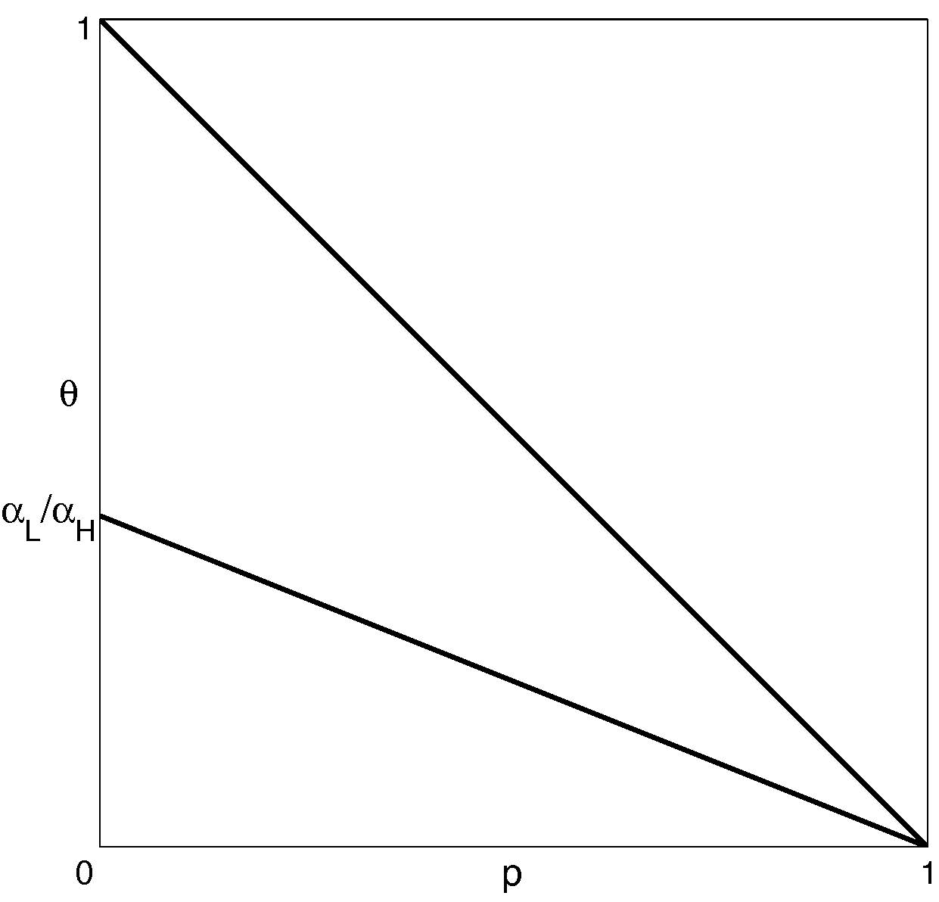
Core Mechanism
BC Slack
BC Binding
No bubbles
Bubbles with only crowd-out effects
Bubbles with crowd-in and crowd-out effects

Slide 5
Comments
What could make the rise of bubbles more likely?
Suppose that economic boom is represented by a rise in p, the economy is more likely to enter into the no bubble region. Counter-intuitive?
What could affect the probability of the bubble bursts?
Do business cycles result in the boom-bust cycles of bubbles or the other way around? (Sentiments, Angeletos and La’o, 2013)
Are bubbles a form of financial innovations to mitigate financial market imperfections?
The social value vs. the private value of bubbles
Can treasury bonds be used to achieve the efficient allocation without generating the boom and bust cycles?
Public and private liquidity provision: complementarity or substitutability

Slide 6
Wrap-up
An elegant and solid analysis on critical theoretical and policy issues
A useful framework for many other related topics
Business cycles and boom-bust of bubbles
International capital flows and bubbles
International coordination of bailout policies

